Slide 1
18CSE390T
Computer Vision
S4-Split and Merge

Slide 2
Split and merge
Recursively splitting the whole image into pieces based on region statistics
Merging pixels and regions together in a hierarchical fashion.
It is also possible to combine both splitting and merging by starting with a medium-grain segmentation (in a quadtree representation) and then allowing both merging and splitting operations
Watershed
Technique related to thresholding, since it operates on a grayscale image, is watershed com-putation
Segments an image into several catchment
basins, which are the regions of an image (interpreted as a height field or landscape) where rain would flow into the same lake

Slide 3
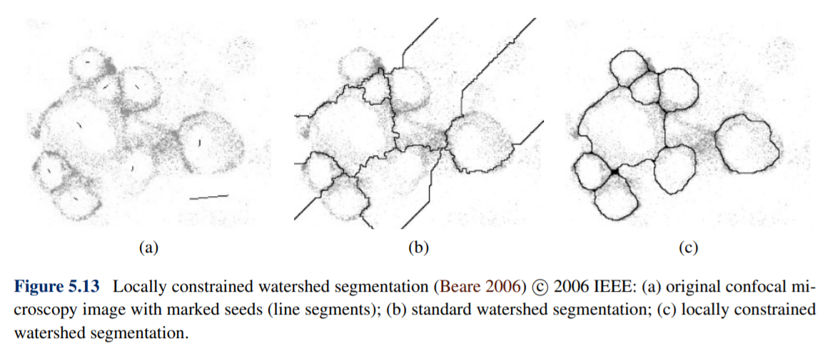

Slide 4
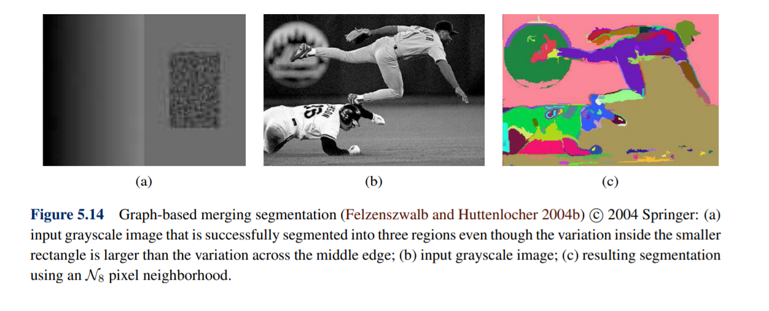
Graph-based segmentation

Slide 5
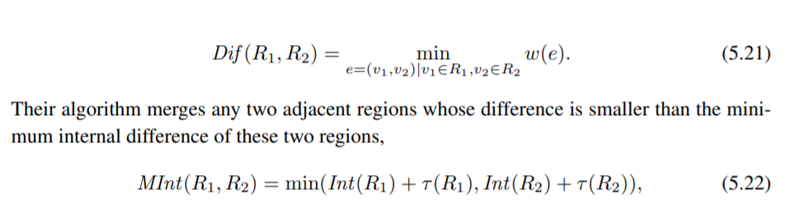

Slide 6
